Slide 1

Paper Title : PrivLogEdu: An Innovative Framework for Real-Time Engagement Recognition in Hybrid Classrooms Using Non-Visual Log Data While Maintaining Privacy.
Paper Id : 905
Authors : Sighakolli Naga Tirumala Rao, Palutla Venkata Naveen, Jonnalagadda Mahesh Babu, V.Srilakshmi, Jyothi M, Gujjula Ramanareddy, Dodda Venkata Reddy.

Slide 2

Paper_id : 905
Problem / Motivation
Digital & hybrid classrooms require accurate engagement tracking.
Existing systems depend on camera-based emotion detection.
Visual methods create privacy issues, high costs, and ethical concerns.
Need for a privacy-preserving, real-time engagement model.
Research Scope / Goal
Predict engagement levels (low / moderate / high).
Use only non-visual behavioral logs.
Maintain high accuracy + complete privacy.
Expected Outcomes
A scalable, ethical engagement-detection framework.
Real-time use in hybrid classrooms.
99.91% accuracy using EdNet-KT1.

Slide 3

Paper_id : 905
Background Context
AI in education is widely used in learning analytics and personalization.
Engagement strongly influences learning outcomes, retention, and participation.
Importance of the Problem
Camera-based systems = privacy risk + high deployment cost
Institutions need non-intrusive engagement methods
Log data gives rich behavioral patterns
Technology Overview
Skill2Vec embeddings
GRU-Attention deep learning
Feature engineering + temporal log analysis
Key Challenges
Representing non-visual behaviors as features
Handling long sequences
Class imbalance
Real-time inference speed

Slide 4

Paper_id : 905
Past Approaches
Visual emotion detection (face, eye tracking)
Federated learning using log sequences
Transformer-based student modeling
GRU/LSTM temporal prediction models
Existing Limitations
Visual systems: privacy risks, cultural bias, lighting issues
Many models offer only binary engagement
Difficulty handling multi-class predictions
Weak performance on large datasets
Novelty of PrivLogEdu
100% non-visual, privacy-safe
High accuracy (99.91%)
Skill2Vec + GRU-Attention hybrid approach
Works in real-time for hybrid classrooms

Slide 5
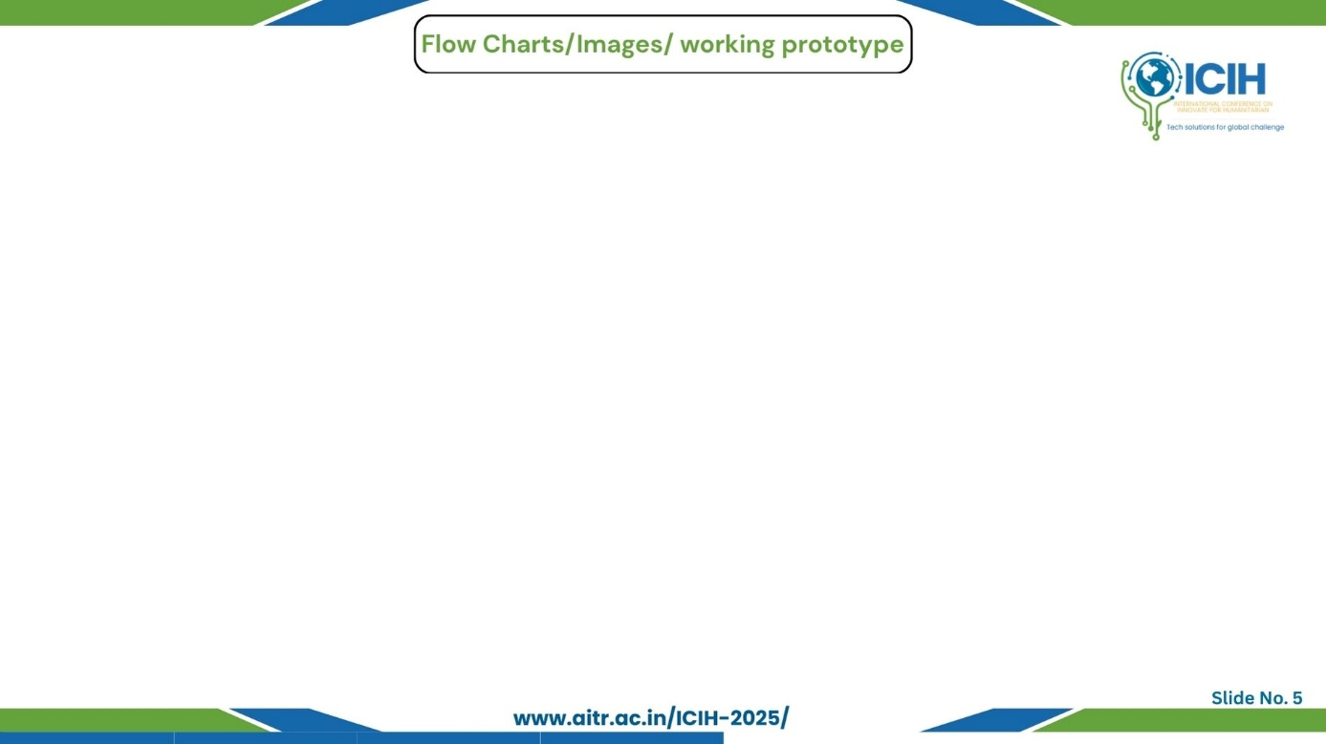
Paper_id : 905
Workflow Overview
Collect learner log data (time, accuracy, skill ID).
Preprocess: clean data, split sessions, normalize values.
Engineer features: avg. time/question, accuracy, burstiness, skill-switch rate.
Generate Skill2Vec embeddings for skill sequences.
Model: GRU + Attention for temporal pattern learning.
Output: Low / Moderate / High engagement.
Flowchart (Short)
Log Data → Preprocessing → Features + Skill2Vec → GRU-Attention → Engagement Prediction
Architecture Summary
Input Features → GRU Layer → Attention → Dense Layer → Softmax (3 classes)
Prototype / UI Images
Feature pipeline diagram
Model architecture block
Brief Captions
Logs: Non-visual, privacy-safe behavior data
Features: Key learning indicators
Skill2Vec: Captures skill relationships
GRU: Learns sequences
Attention: Focuses on important actions
Output: Real-time engagement

Slide 6
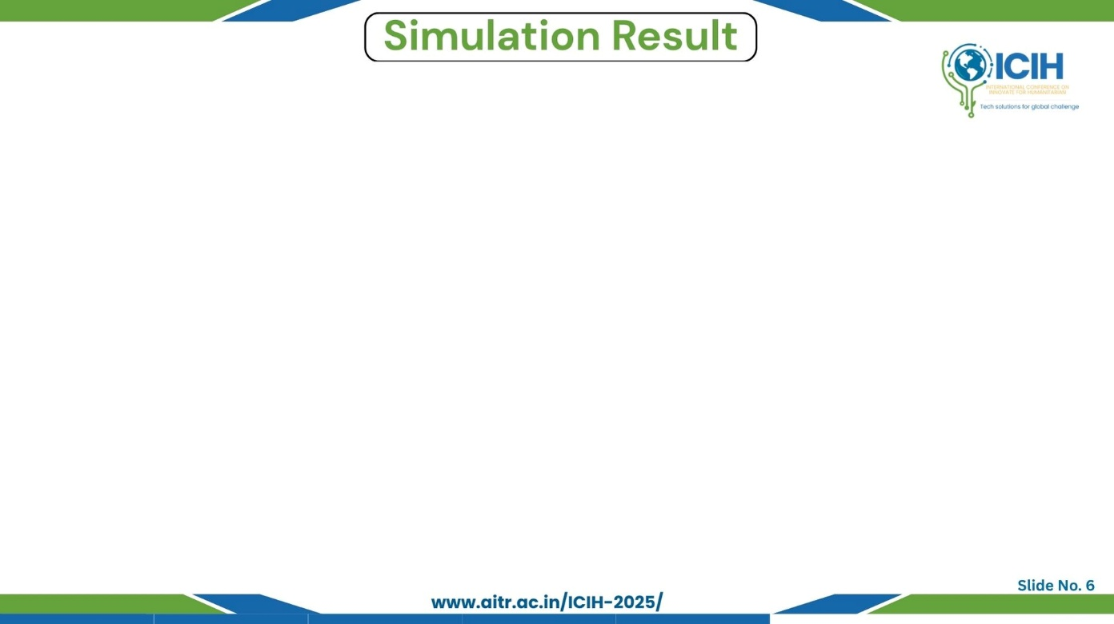
Paper_id : 905
Graphs / Tables / Charts
Accuracy curve: Stable training & testing convergence
Confusion matrix: Very low misclassification
Classification table: Precision/Recall ≈ 1.00 for major classes
Test Results (Short)
Accuracy: 99.91%
F1-Score: Near perfect
Precision/Recall: Excellent for low & moderate classes
Model Stability: No overfitting observed
Performance Comparison
LSTM: 83.5%
GRU: 86.7%
Transformer: 94.1%
PrivLogEdu: 99.91% (highest performance)
Brief Observations & Insights
Non-visual logs provide rich engagement patterns
Skill2Vec + GRU-Attention gives strong temporal learning
Extremely high accuracy with low computational cost
Fully privacy-preserving—no visual data required

Slide 7

Paper_id : 905
Main Findings
Non-visual logs can accurately detect engagement
GRU + Attention + Skill2Vec achieves 99.91% accuracy
Works effectively in real-time hybrid classrooms
Advantages
Privacy-preserving (no camera data)
Low computational cost
High generalization and stability
Scalable to large educational systems
Limitations
Class imbalance in high-engagement category
Tested mainly on EdNet-KT1 dataset
Depends on quality of log data
Key Contributions
Novel non-visual engagement framework
Advanced feature engineering & Skill2Vec embeddings
GRU-Attention architecture for sequential behavior modeling
High-performance multi-class engagement prediction
Future Scope
Expand to K–12 & university datasets
Add keystroke + navigation behavioral data
Apply federated learning for cross-institution training
Real-world deployment pilot in hybrid classrooms

Slide 8

Paper_id : 905
A. Kumar, R. Patel, and M. Sharma, “Federated engagement prediction in hybrid classrooms using non-visual interaction data,” IEEE Trans. Learn. Technol., vol. 18, no. 3, pp. 452–463, May 2025.
X. Li, H. Chen, and Y. Sun, “Privacy-aware student behavior modeling using sequence-based log analytics,” Comput. Educ., vol. 198, Feb. 2025.
J. Lee, S. Choi, and P. Kang, “Challenges of visual emotion detection in online education,” IEEE Access, vol. 13, pp. 50122–50134, 2025.
A. Alzahrani, M. Alharthi, and L. Shao, “Non-intrusive behavioral features for scalable engagement detection,” Int. J. Artif. Intell. Educ., vol. 35, pp. 143–160, 2025.
Z. Wang, F. Liu, and C. Zhang, “Transformer-enhanced temporal models for student engagement analysis,” Proc. IEEE AIED, pp. 211–219, 2025.
P. Singh and D. Arora, “Statistical feature engineering for log-based educational data mining,” J. Educ. Data Sci., vol. 12, no. 1, pp. 77–89, 2024.
M. Huang, Y. Zhao, and X. Wu, “Skill graph neural networks for personalized learning analytics,” IEEE Trans. Knowl. Data Eng., vol. 37, no. 8, pp. 920–933, Aug. 2024.
Q. Chen, L. Han, and S. Zhou, “Behavioral analytics vs visual analytics for engagement detection,” Comput. Educ. Rev., vol. 64, pp. 29–46, 2024.
R. Wu, H. Liu, and J. Park, “Attention-augmented GRU models for educational sequence prediction,” IEEE Access, vol. 12, pp. 102344–102357, 2024.
S. Zhang, Y. Tan, and F. Xie, “Improving EdNet engagement prediction using transformers,” Proc. EDM, pp. 98–107, 2024.

Slide 9

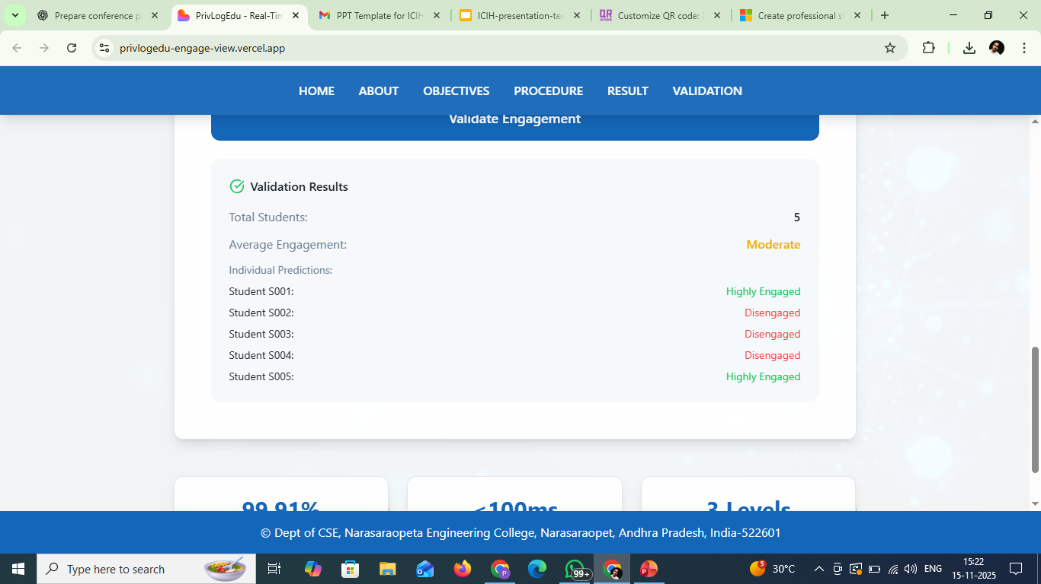
Paper_id : 905
Thank You So Much

